Slide 1

Opening Music
Bagpiper Ben Turner and 82nd ABN Brass Quintet
Welcome
COL (Ret) Don Goss
Invocation
Rev. Trey Majure
Presentation of the Colors
Union Pines JROTC Color Guard
Pledge of Allegiance
Alexander Goss
National Anthem
Golf Capital Chorus
Memorial Address
COL (Ret) Don Goss
Taps
82nd ABN Brass Quintet
Benediction
Rev Trey Majure
Closing Comments
President COL (Ret) Walt Havenstein
God Bless America
Golf Capital Chorus
Memorial Day Service
25 May 2026
The Village Chapel
Pinehurst, NC
Sequence of Events
The Village Chapel
Pinehurst, NC
25 May 2026
1100 HRS

Slide 2
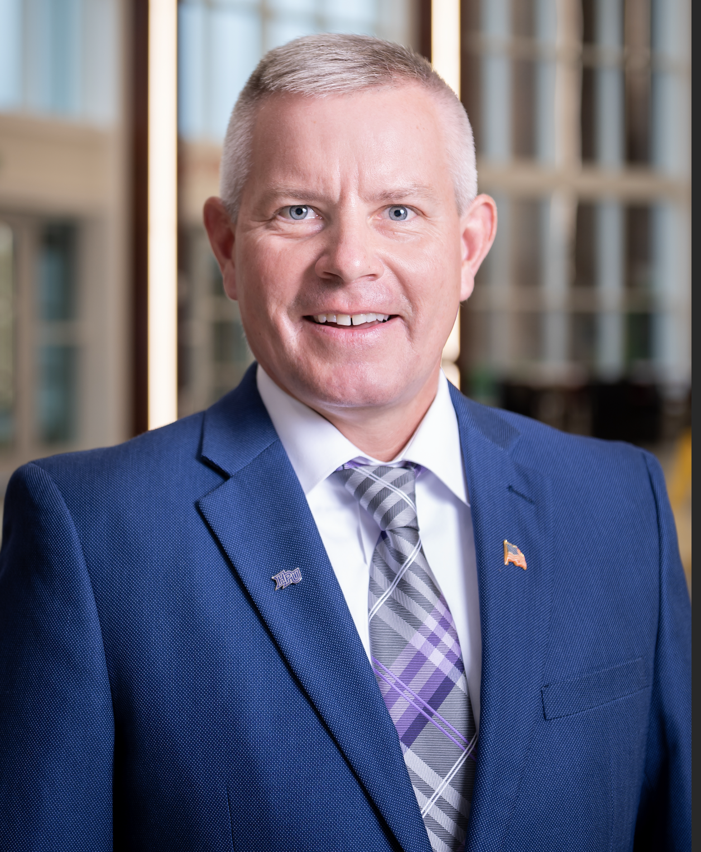
COL (Ret) Don Goss is a Professor in the Department of Physical Therapy at High Point University in High Point, NC. He is also a Principal Investigator with the Geneva Foundation at Womack Army Medical Center at Fort Bragg, NC with over $10M in DoD grants.
Don earned a direct commission in the US Army Medical Specialists Corps in 1995 after graduating from Denison University where he met his wife Holly Jean of nearly 30 years. They were married in 1995 and moved to San Antonio 3 weeks later. Don earned his Masters in Physical Therapy in 1997 and then his Doctorate in PT in 2007 both from Baylor University, and a PhD in Human Movement in 2012 from the University of North Carolina at Chapel Hill.
Over an Army career spanning 25 years, COL (Ret) Goss served in several clinical, operational, and academic assignments. Don was a staff PT at Fort Jackson, SC before heading to Camp Casey Korea in 1999 to be the Division PT for the 2nd Infantry Division. Upon returning home, Don and Holly chose West Point, NY to join the sports medicine team at Army. Leaving West Point in 2004, Don and Holly went to Stuttgart, GE, where he opened a direct access PT clinic and enjoyed traveling all over Europe. Don and Holly first came to NC for a job with a Special Mission Unit at the United States Army Special Operations Command at Fort Bragg, NC. Don deployed 6 times with this unit from 2006 – 2009. Don was then Blessed with a Long-Term Health and Educational Training scholarship to matriculate to UNC for his PhD. During this time, Alexander Josef was born! Upon completion of his PhD, Don taught physical therapy at the Army-Baylor DPT program at Fort Sam Houston, TX. In 2014, Don was ordered back to West Point to lead the PT clinics and to start a physical therapy sports medicine fellowship. Don and Holly returned to Pinehurst in 2019 for Don to lead the physical therapy clinics on Fort Bragg and to retire in 2020.
His awards and decorations include the Legion of Merit, Defense Meritorious Service Medal, Meritorious Service Medal (w/ 3OLC), Airborne, Air Assault, Gold German Badge, and others.
In his spare time, Don enjoys spending time with his family (Holly and Zander), golfing, running, going to the pool or the lake, and helping golfers with their fitness with his Titleist Medical practice at the Pinehurst Country Club.
COL (Ret) Don Goss

